Slide 1
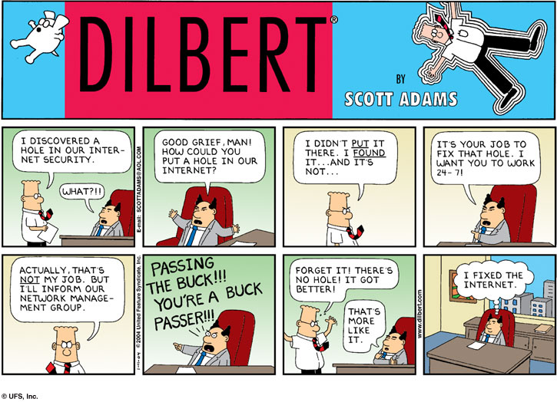

Slide 2
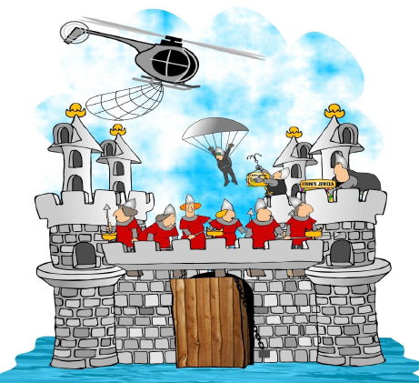
Information Technology Infrastructure
Chapter 8
Securing Information Systems
MFIS
Lisa Murphy
Notes:
2

Slide 3

Learning Objectives
LEARNING OBJECTIVES
Week 9
Explain why information systems are vulnerable to destruction, error, and abuse.
Assess the business value of security and control.
Identify the components of an organizational framework for security and control.
Evaluate the most important tools and technologies for safeguarding information resources.
Week 10

Slide 4

Boston Celtics Score Big Points Against Spyware
Problem:
Spyware infecting laptops during team travel affecting accessibility and performance of proprietary system
Solutions:
Deploy security software to reduce spyware.
Mi5 Network’s Webgate security appliance tool sits between corporate firewall and network to prevent spyware entering network or infected computers connecting to network
Demonstrates IT’s role in combating malicious software
Illustrates digital technology’s role in achieving security on the Web
Notes:
4

Slide 5
What Could Possibly Go Wrong?
No Firewall/Antivirus Software?
Your computer could be disabled in seconds
It might take days/weeks to recover
Can’t sell to customers
Can’t place orders with suppliers
System penetrated by outsiders
Valuable/confidential data stolen or destroyed
Out of business!!!

Slide 6
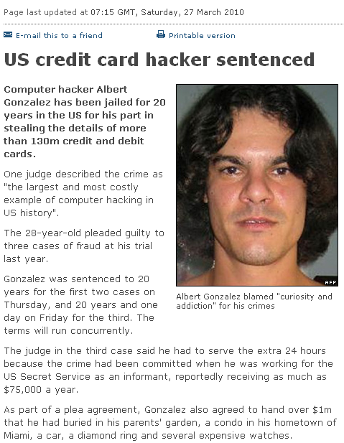
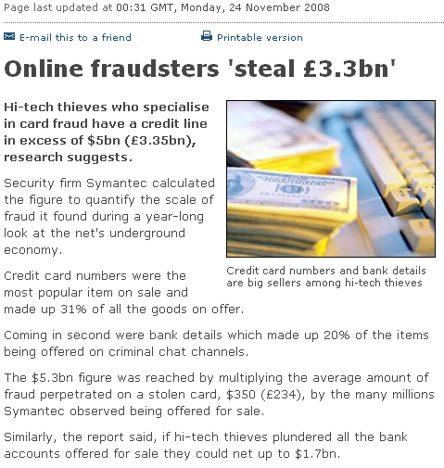
Cyber crime

Slide 7
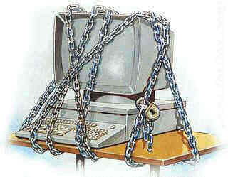
System Vulnerability and Abuse
Security:
Policies, procedures and technical measures used to prevent unauthorized access, alteration, theft, or physical damage to information systems
Controls:
Methods, policies, and organizational procedures that ensure safety of organization’s assets; accuracy and reliability of its accounting records; and operational adherence to management standards
Notes:
7

Slide 8
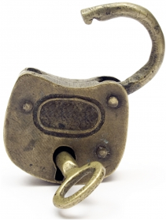
Why systems are vulnerable
Hardware problems
Breakdowns, configuration errors, damage from improper use or crime
Software problems
Programming errors, installation errors, unauthorized changes)
Disasters
Power failures, flood, fires, etc.
Use of networks and computers outside of firm’s control
E.g., with domestic or offshore outsourcing vendors
Notes:
8

Slide 9
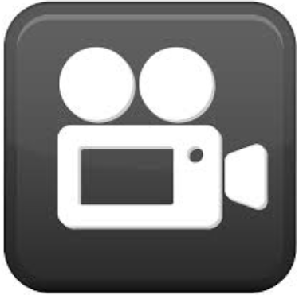
E xercise 1 – Computer Security
What are the ways to protect your information?
Notes:
9

Slide 10
E xercise 1 – Computer Security
Ways to protect your information?
Install security software – Set the software to update automatically. Set your OS to update automatically as well.
Don’t open any email that looks dodgy – it could be harmful
Treat your financial information like cash
Do research on websites before buying a product
Don’t enter in information if the website doesn’t start with “https”
Notes:
10

Slide 11
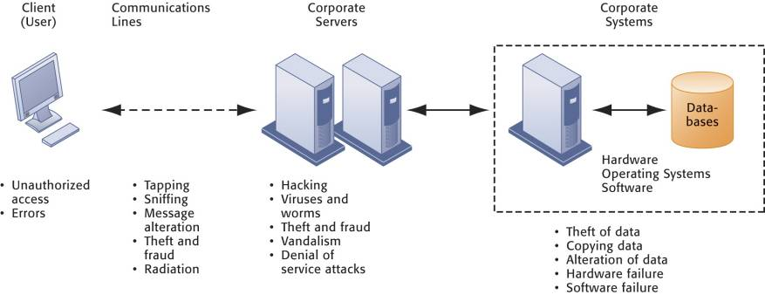
Contemporary Security Challenges and Vulnerabilities
The architecture of a Web-based application typically includes a Web client, a server, and corporate information systems linked to databases. Each of these components presents security challenges and vulnerabilities. Floods, fires, power failures, and other electrical problems can cause disruptions at any point in the network.
Notes:
11

Slide 12

Internet vulnerabilities
Network open to anyone
Size of Internet means abuses can have wide impact
Use of fixed Internet addresses with permanent connections to Internet eases identification by hackers
E-mail attachments
E-mail used for transmitting trade secrets
IM messages lack security, can be easily intercepted
Notes:
12

Slide 13

NCI
Major Threats
Phishing
EXE and ZIP downloads
USB keys
Social Networking
Twitter
Facebook
Games

Slide 14
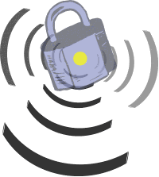
Wireless security challenges
Radio frequency bands easy to scan
SSIDs (service set identifiers)
Identify access points
Broadcast multiple times
War driving
Eavesdroppers drive by buildings and try to intercept network traffic
When hacker gains access to SSID, has access to network’s resources
WEP (Wired Equivalent Privacy)
Security standard for 802.11
Basic specification uses shared password for both users and access point
Users often fail to use security features
Notes:
14

Slide 15
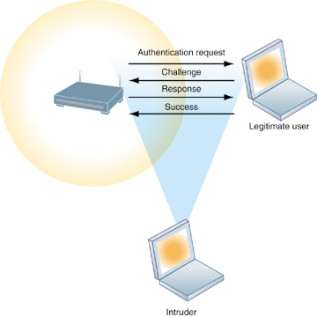
Wi-Fi Security Challenges
Many Wi-Fi networks can be penetrated easily by intruders using sniffer programs to obtain an address to access the resources of a network without authorization.
FBI – 3 minutes to break into a protected Wi-Fi network
Notes:
15

Slide 16


E xercise 2 – The worst data theft
Read the Case-Study and then discuss the following questions:
List and describe the security control weaknesses at TJX Companies
What management, organization, and technology factors contributed to these weaknesses?
What was the business impact of TJX’s data loss on TJX, consumers, and banks?
How effectively did TJX deal with these problems?
Who should be held liable for the losses caused by the use of fraudulent credit cards in this case? The banks issuing the cards or the consumers? Justify your answer.
What solutions would you suggest to prevent the problems?
Hand-Out
Notes:
16

Slide 17

Break Time
10 Minutes break!!

Slide 18
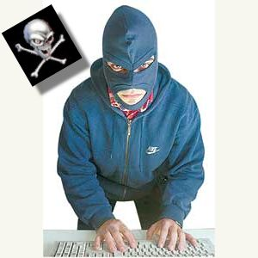
Hackers and computer crime
Hackers vs. crackers
Activities include
System intrusion
Theft of goods and information
System damage
Cybervandalism
Intentional disruption, defacement, destruction of Web site or corporate information system
Notes:
18

Slide 19
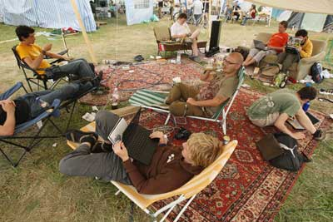
The Hacker Toolbox
Malicious hackers use programs to:
Log keystrokes
Hack passwords
Infect a computer or system with a virus
Gain backdoor access
Create zombie computers
Spy on e-mail
Hackers from around the world gather at camps to practice their hobby and trade tips.

Slide 20
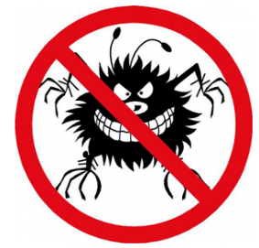
Malicious software (Malware)
Viruses: Rogue software program that attaches itself to other software programs or data files in order to be executed
Worms: Independent computer programs that copy themselves from one computer to other computers over a network
Trojan horses: Software program that appears to be benign but then does something other than expected
Spyware: Small programs install themselves surreptitiously on computers to monitor user Web surfing activity and serve up advertising
Key loggers: Record every keystroke on computer to steal serial numbers, passwords, launch Internet attacks
Notes:
20

Slide 21
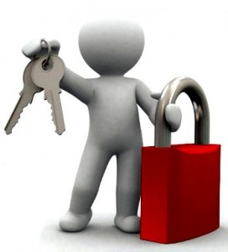
Malicious software (malware)
Spoofing
Misrepresenting oneself by using fake e-mail addresses or masquerading as someone else
Redirecting Web link to address different from intended one, with site masquerading as intended destination
Sniffer: Eavesdropping program that monitors information traveling over network
Denial-of-service attacks (DoS): Flooding server with thousands of false requests to crash the network
Distributed denial-of-service attacks (DDoS): Use of numerous computers to launch a DoS
Botnets: Networks of “zombie” PCs infiltrated by bot malware
Notes:
21

Slide 22
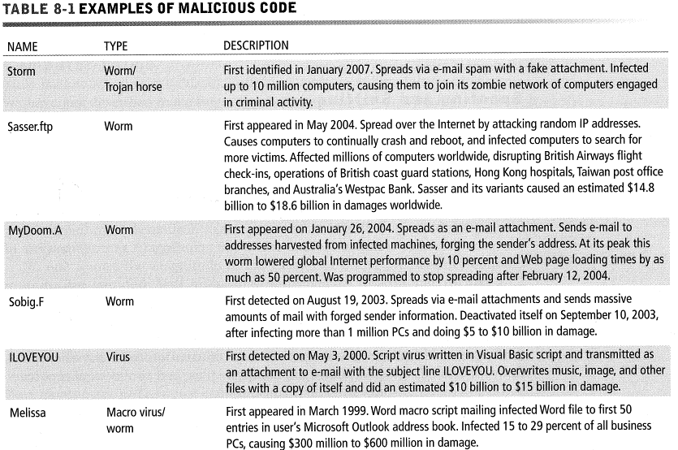
Malicious Code

Slide 23
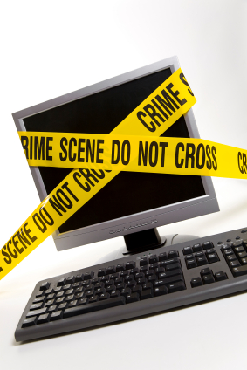
Computer crime
Defined as “any violations of criminal law that involve a knowledge of computer technology for their perpetration, investigation, or prosecution”
Computer may be target of crime, e.g.:
Breaching confidentiality of protected computerized data
Accessing a computer system without authority
Computer may be instrument of crime, e.g.:
Theft of trade secrets
Using e-mail for threats or harassment
Notes:
23

Slide 24
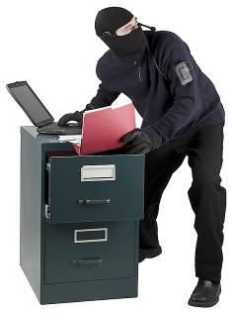
Identity theft
Identity theft:
Theft of personal Information (social security id, driver’s license or credit card numbers) to impersonate someone else
Precautions:
Keep sensitive and financial documents in an encrypted file on your hard drive, or remove to a flash drive
Don’t allow your internet browser to store passwords
Delete cookies and browsing history at least once a fortnight
Set a password to access your computer. And don’t keep it on a sticky note attached to the screen
Notes:
24

Slide 25
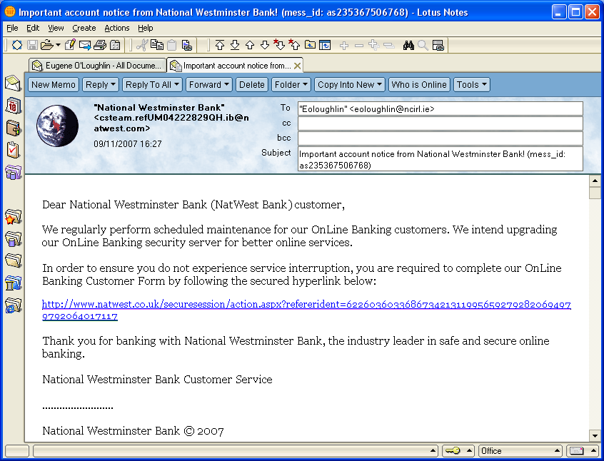
Phishing
Phishing: Setting up fake Web sites or sending e-mail messages that look like legitimate businesses to ask users for confidential personal data.
Notes:
25

Slide 26
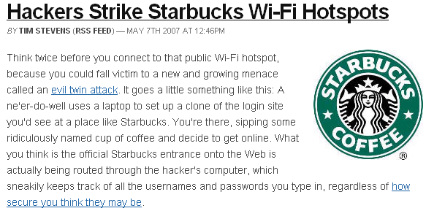
Evil Twins/Pharming
Evil twins: Wireless networks that pretend to offer trustworthy Wi-Fi connections to the Internet
Pharming: Redirects users to a bogus Web page, even when individual types correct Web page address into his or her browser
Notes:
26

Slide 27
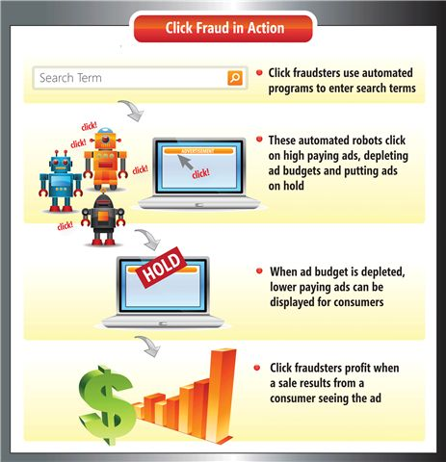
Click Fraud
Click fraud
Individual or computer program clicks online ad without any intention of learning more or making a purchase
Notes:
27

Slide 28
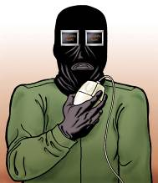
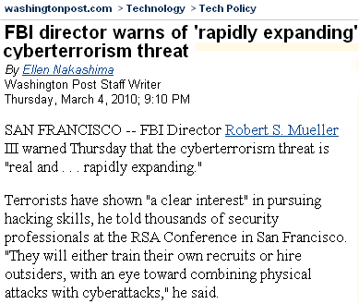
Global threats
Cyberterrorism and cyberwarfare
Concern that Internet vulnerabilities and other networks make digital networks easy targets for digital attacks by terrorists, foreign intelligence services, or other groups
Notes:
28

Slide 29
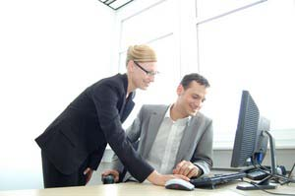
Internal threats
Employees
Security threats often originate inside an organization
Inside knowledge
Sloppy security procedures
User lack of knowledge
Social engineering:
Tricking employees into revealing their passwords by pretending to be legitimate members of the company in need of information
Notes:
29

Slide 30

E xercise 3 – Question Time
List and describe the most common threats against contemporary information systems?
Define malware and distinguish among a virus, a worm and a Trojan horse?
Define a hacker and explain how hackers create security problems and damage systems
Define identify theft and phishing and explain why identity theft is such a big problem today?

Slide 31

RECAP
To gain an understanding of the following:
Explain why information systems are vulnerable to destruction, error, and abuse.
Assess the business value of security and control.
Identify the components of an organizational framework for security and control.
Evaluate the most important tools and technologies for safeguarding information resources.

